Slide 1
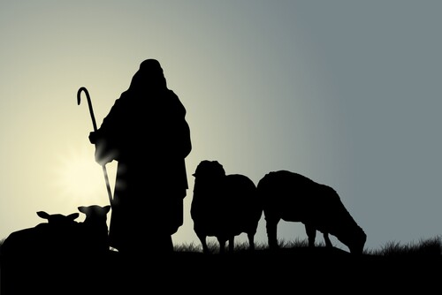
Developing Elderships
A Biblical and Time-Honored Approach for Identifying and Selecting Overseers
Part I
Charlotte Church
March 5, 2025

Slide 2

Experience
25 Years of Ministry, 13 Years of Consulting
1100 Interviews, 1000s More Surveyed
Notes:
I have 25 years involvement in serving ministries of many sizes, in different capacities. Over the last 13 years I’ve consulted on 25 occasions, ranging from a a few weeks to six months, among churches, charities, and schools. My approach has involved numerous interviews and surveys purposed to get the longer history and the recent situation.

Slide 3







Experience with Elderships
Jacksonville

Slide 4
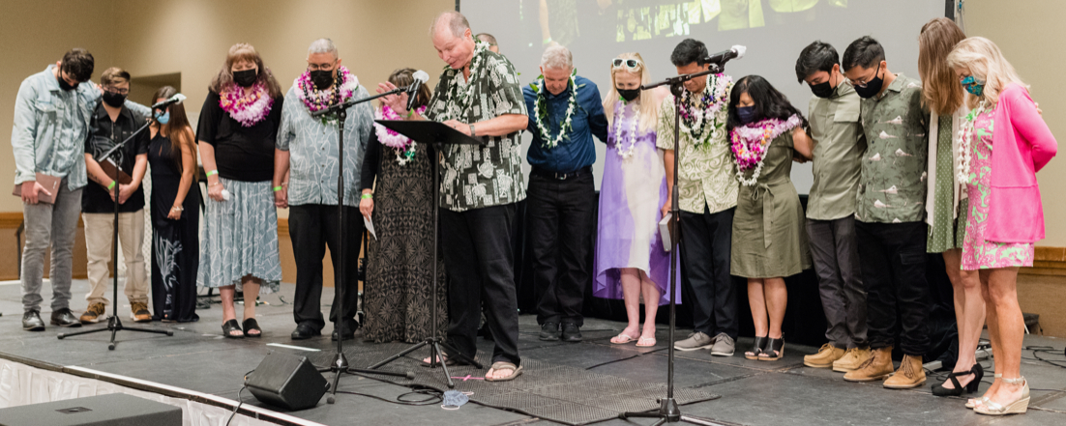
Oahu, 2021

Slide 5
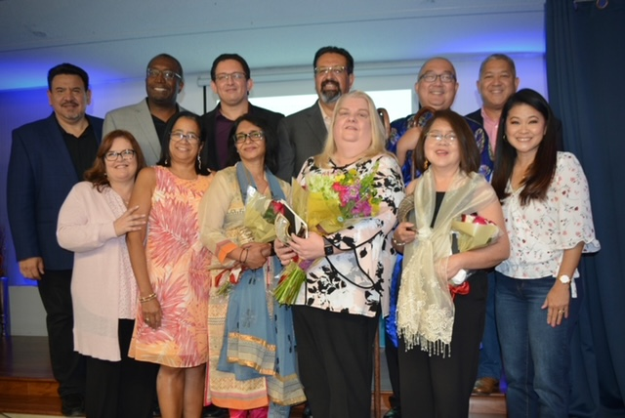
Metro LA
2022

Slide 6
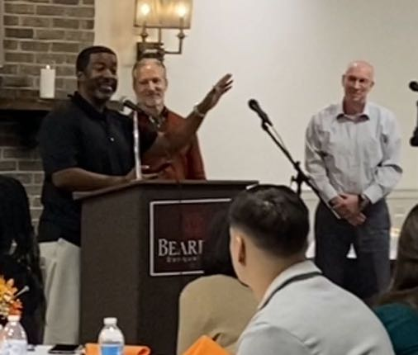
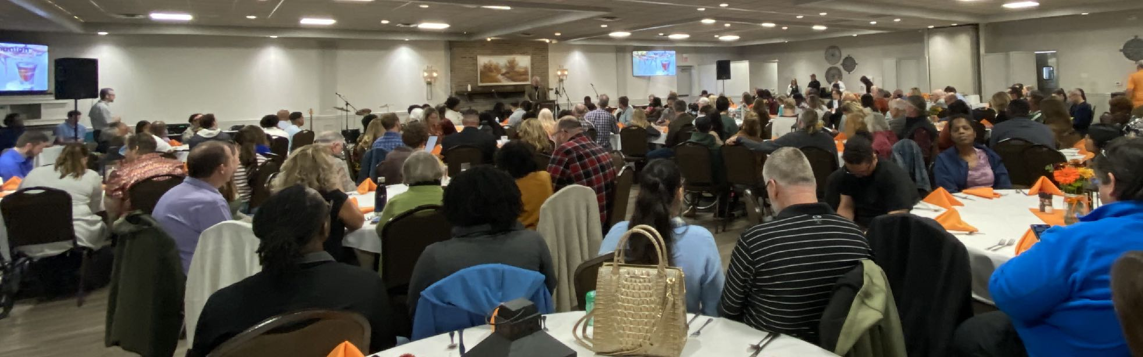
Knoxville, 2023

Slide 7
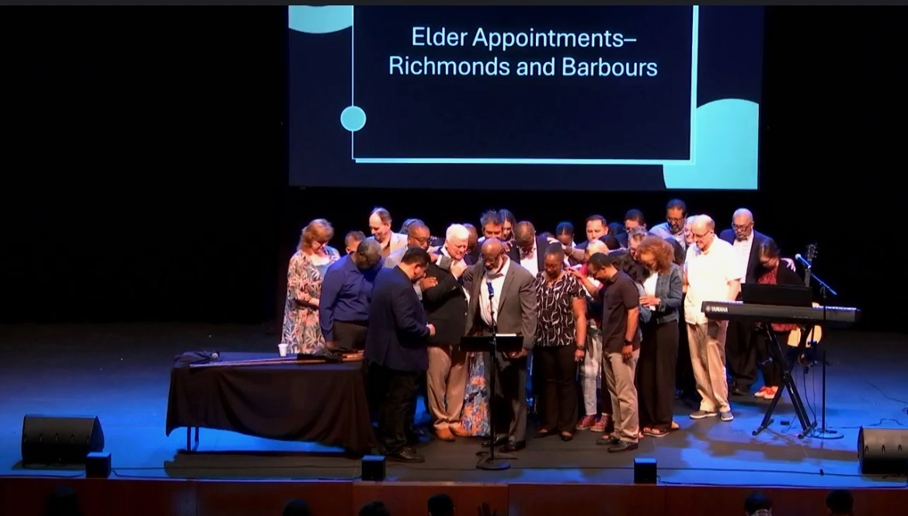
Orange County, 2024

Slide 8

Situations Requiring Shepherds
Standard Responsibilities
Modern Challenges
Marriage & Family Matters
Governance, major decisions
Ministering
Problem-solving
Teaching
Preaching*
Knowing the flock
Reputation with outsiders
Abuse, trauma
Divorce, Remarriage
Sexual scandal, other harms
Power struggles/wolves
Pyramid Schemes
Protecting children
Doctrinal threats
Other complexities

Slide 9




Developing Elderships
March 5
March 19
The Scriptures
Including the churches after the apostles
Lessons
Churches of Christ and Discipling Churches
Observations
Present day elderships
A Process
Customizable for congregations of all sizes

Slide 10
The Scriptures
Including the churches after the apostles

Slide 11
Considerations
How would we recognize a candidate for eldership?
What are the demands placed on a shepherd/elder?
Are the descriptions in 1 Timothy and Titus prescriptive or descriptive?
What are the risks for an elder?
Are there different kinds of elders?
What is the authority dynamic with other roles?
Who makes decisions? How are decisions made?

Slide 12


The Scriptures
1
OLD TESTAMENT
Important spiritual matters (Leviticus 4:13–21)
Share the burdens of the people (Numbers 11:16–17)
Dealing with crimes (Deuteronomy 21:1–9)
Disciplinary issues (Deuteronomy 22:13–21)
Deuteronomy 25— administrator justice and for protection.
Helping the flock remember their history (Deuteronomy 32:7)
Ministry - feeding, strengthening, healing, binding up the broken, seeking lost sheep, caring for the perishing, and sustaining the standing. (Ezekiel 34:1-17)

Slide 13
Old Testament
1
The Lord said to Moses: “Bring me seventy of Israel’s elders who are known to you as leaders and officials among the people. Have them come to the tent of meeting, that they may stand there with you. I will come down and speak with you there, and I will take some of the power of the Spirit that is on you and put it on them. They will share the burden of the people with you so that you will not have to carry it alone. — Numbers 11:16-17

Slide 14
Old Testament
1
Remember the days of old; consider the generations long past.
Ask your father and he will tell you, your elders, and they will explain to you. — Deuteronomy 32:7

Slide 15
Old Testament
1
The word of the Lord came to me: “Son of man, prophesy against the shepherds of Israel*; prophesy and say to them: ‘This is what the Sovereign Lord says: Woe to you shepherds of Israel who only take care of yourselves! Should not shepherds take care of the flock? — Ezekiel 34:1-2
* kings, Levites, priests, elders, etc.
As a shepherd looks after his scattered flock when he is with them, so will I look after my sheep. I will rescue them from all the places where they were scattered on a day of clouds and darkness. I will bring them out from the nations and gather them from the countries, and I will bring them into their own land. I will pasture them on the mountains of Israel, in the ravines and in all the settlements in the land. — Ezekiel 34:12–13

Slide 16
Old Testament
1
I will tend them in a good pasture, and the mountain heights of Israel will be their grazing land. There they will lie down in good grazing land, and there they will feed in a rich pasture on the mountains of Israel. I myself will tend my sheep and have them lie down, declares the Sovereign Lord. I will search for the lost and bring back the strays. I will bind up the injured and strengthen the weak, but the sleek and the strong I will destroy. I will shepherd the flock with justice. — Ezekiel 34:14–16

Slide 17
Old Testament
1
“ ‘As for you, my flock, this is what the Sovereign Lord says: I will judge between one sheep and another, and between rams and goats. Is it not enough for you to feed on the good pasture? Must you also trample the rest of your pasture with your feet? Is it not enough for you to drink clear water? Must you also muddy the rest with your feet? Must my flock feed on what you have trampled and drink what you have muddied with your feet? “ — Ezekiel 34:17-19

Slide 18
Old Testament
1
“ ‘Therefore this is what the Sovereign Lord says to them: See, I myself will judge between the fat sheep and the lean sheep. Because you shove with flank and shoulder, butting all the weak sheep with your horns until you have driven them away, I will save my flock, and they will no longer be plundered. I will judge between one sheep and another. — Ezekiel 34:20-22

Slide 19
The Scriptures
1
NEW TESTAMENT
Handling financial matters (Acts 11:29–30)
Involvement in major decisions (Acts 15:1-29)
Guardians of the flock (Acts 20:13-30)
Selection under normal circumstances (1 Timothy 3:1-13)
Some elders direct affairs (1 Timothy 5:17)
Urgent placement because there is a problem (Titus 1:5-16)
Additional role(s) of elders (1 Timothy 4:14, 5:17-21)
Considerations for shepherds (1 Peter 5:1-4)

Slide 20
Inter-Testament
1
“At the end of the third or beginning of the second century BC under the Seleucid king Antiochus II, we have evidence of the existence of a council of elders consisting of seventy (or seventy-one) members, the Sanhedrin”.
—Evans, D. & Godwin, J., Elder governance

Slide 21
Gospels/Acts
1
JUDAISM
Alongside chief priests
Many abused their position
Part of the conspiracy against Jesus
Opposed the apostles, complicit in Stephen’s death (Acts 4-7)
Good examples: Nicodemus and Joseph of Arimethea

Slide 22
Acts
THE CHURCH
Barnabas and
Paul
Investigators
11:22-26, 15:12
Believers Among
the Pharisees
15:5
An Illustration: The Jerusalem Council
The First Major Controversy (Acts 10-15)
Simon Peter
Witness to the Holy Spirit (Acts 10:1-48, 15:7-11)
Apostles and Elders (15:6)
The Whole
Church
(15:22)
James (elder)
15:13-21

Slide 23
Acts
1
THE CHURCH
From Miletus, Paul sent to Ephesus for the elders of the church.
… Keep watch (proséchō)* over yourselves and all the flock of which the Holy Spirit has made you overseers. Be shepherds of the church of God, which he bought with his own blood. I know that after I leave, savage wolves will come in among you and will not spare the flock. Even from your own number men will arise and distort the truth in order to draw away disciples after them. So be on your guard! Remember that for three years I never stopped warning each of you night and day with tears. — Acts 20:28-31
As a nautical term, it means to hold a ship in a direction, to sail towards

Slide 24
The Letters
1
Here is a trustworthy saying: Whoever aspires to be an overseer desires a noble task. Now the overseer is to be above reproach, faithful to his wife, temperate, self-controlled, respectable, hospitable, able to teach, not given to drunkenness, not violent but gentle, not quarrelsome, not a lover of money. He must manage his own family well and see that his children obey him, and he must do so in a manner worthy of full respect. (If anyone does not know how to manage his own family, how can he take care of God’s church?) He must not be a recent convert, or he may become conceited and fall under the same judgment as the devil. He must also have a good reputation with outsiders, so that he will not fall into disgrace and into the devil’s trap. — 1 Timothy 3:1-7

Slide 25
The Letters
1
Deacons, likewise, are to be men worthy of respect, sincere, not indulging in much wine, and not pursuing dishonest gain. They must keep hold of the deep truths of the faith with a clear conscience. They must first be tested; and then if there is nothing against them, let them serve as deacons.
In the same way, their wives are to be women worthy of respect, not malicious talkers but temperate and trustworthy in everything.
—1 Timothy 3:8–11

Slide 26
The Letters
1
An elder must be blameless, faithful to his wife, a man whose children believe (Gk. pistes) and are not open to the charge of being wild and disobedient. Since an overseer manages God’s household, he must be blameless—not overbearing, not quick-tempered, not given to drunkenness, not violent, not pursuing dishonest gain. Rather, he must be hospitable, one who loves what is good, who is self-controlled, upright, holy and disciplined. He must hold firmly to the trustworthy message as it has been taught, so that he can encourage others by sound doctrine and refute those who oppose it. — Titus 1:6-9

Slide 27
The Letters
1
To the elders among you, I appeal as a fellow elder and a witness of Christ’s sufferings who also will share in the glory to be revealed: Be shepherds of God’s flock that is under your care, watching over them—not because you must, but because you are willing, as God wants you to be; not pursuing dishonest gain, but eager to serve; not lording it over those entrusted to you, but being examples to the flock. — 1 Peter 5:1–4

Slide 28
After the Apostles
1
Reactivity to heresy led to increased control
Overly directive tone in 1 Clement, ‘96AD
Hierarchy of elders, Ignatius, ~110AD
Distinguish bishop/overseer from elder
Increased power differential led to rivalrous pursuit of positions
Contributed to formation of clergy/laity and pyramid structures
The basis of Roman Catholicism (Pope, Cardinals, Bishops, Priests and Deacons)

Slide 29
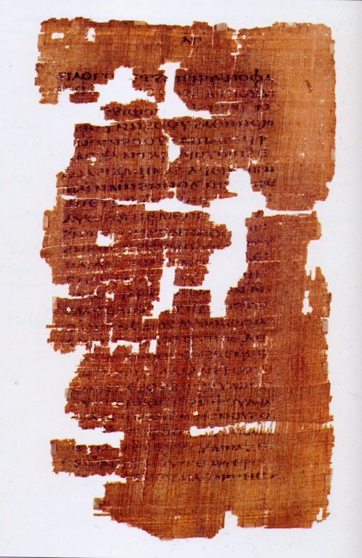
After the Apostles
1
Clement of Rome, ~95AD, is considered the first Church Father
Representatives of Corinth sought help
Response to a dispute in which elders of the Corinthian church had been deposed.
Clement asserted the authority of the elders as rulers of the church
Terminology of military rank and a hierarchical pyramid was promoted

Slide 30
After the Apostles
1
“Be eager to do everything in godly harmony, the overseer presiding in the place of God and the elders in the place of the council of the apostles and the deacons, who are most dear to me, having been entrusted with the service of Jesus Christ.”
Ignatius
to the congregation in Magnesia

Slide 31
After the Apostles
“Wherever the bishop (overseer) appear, there let the multitude be; even as wherever Christ Jesus is, there is the catholic Church. It is not lawful either to baptize, or to hold a love-feast without the consent of the bishop …”
Ignatius
to the congregation in Smyrna

Slide 32
Developing Elderships
March 5
March 19
The Scriptures
Including the churches after the apostles
Lessons
Churches of Christ and Discipling Churches
Observations
Present day elderships
A Process
Customizable for congregations of all sizes

Slide 33
Developing Elderships
A Biblical and Time-Honored Approach for Identifying and Selecting Overseers
Part II
Charlotte Church
March 19, 2025

Slide 34

Lessons
Churches of Christ and Discipling Churches

Slide 35

Lessons Learned
2
STONE-CAMPBELL / RESTORATION MOVEMENT
Elder-led churches
1880s-1930s, evangelists traveled and were supported by groups of churches … including the Churches of Christ (COC)
Evangelists stayed from weeks to up to two years
Elders were locally mission-minded and valued evangelists
COC: Full-time stationed evangelists was a controversial concept
By the 1940s many evangelists were hired to be “preachers”
Elders often muzzled preachers

Slide 36
Lessons Learned
2
INTERNATIONAL CHURCHES OF CHRIST: PRE-2003
Evangelist-led churches
Evangelists stayed, few had elders
Elders were often hand-selected by evangelists
Elders were under evangelists
Evangelists were appointed by evangelists (often from outside)
New hierarchy … the pendulum had swung
The consequences were significant

Slide 37
Lessons Learned
2
AFTER 2003
ICOC structure was gone, new prototypes emerged
Evangelists + Elders + other roles …. slowly improved
Perspectives of members increasingly mattered
More open selection processes
Vetting was more inclusive, using long-time stakeholders and wise members, yet maintained confidentiality
Communication garnered greater trust
Outcomes were less predictable —open to the Spirit
Some maintained the old model

Slide 38
Observations
Present day elderships

Slide 39

Observations
3
AFTER 2003
Importance of teaching the congregation (role, qualifications)—an example from Atlanta
Settle interpretations beforehand—“must be the husband of but one wife” and “believing children”
Important to protect the candidates/families (ex: overall confidentiality, distant past, wellness conditions, challenges with family members, etc.)
Important to not overlook the elder’s wives (1 Timothy 3:11)
…and not overlook a candidate’s situational limitations

Slide 40
Observations
3
DIFFERING POSITIONS ON “BELIEVING CHILDREN”
Where Churches Stand on a Spectrum
(based on a broad inquiry)
1
2
3
4
5
The child or children were obedient
towards their parents during their years at home
The children are obedient, and at least one child is faithful, the spiritual state of other older children is less relevant
All children became Christians but a small fraction left much later on, still in good relationship with their parents
Age appropriate children are baptized, young ones are well-behaved, and none have fallen away
All are baptized and none have ever fallen away
* From “pista tekna" — Titus 1:6

Slide 41
Observations
3
UPDATED CONSIDERATION
The Greek word pistis (traditionally translated “faith”) is better translated “faithfulness,” “fidelity,” “loyalty,” or “allegiance”. If pistis is in reference to a royal leader, or authority figure it is best translated allegiance.
—Matthew Bates. The Gospel Precisely, Gospel Allegiance, Salvation by Allegiance Alone

Slide 42
Observations
3
UPDATED CONSIDERATION
An elder must be blameless, faithful to his wife, a man whose children are allegiant and are not open to the charge of being wild and disobedient. (Titus 1:6)

Slide 43
Observations
3
WISDOM
There is potential for unhealthy ambitions
Clarity is needed with “conflicts of interest” and dual roles—such as when an elder is also an evangelist (1 Tim 5:17) AND when an elder’s child is hired for service in ministry
It’s important not to conflate being very “likable” with qualifications
Ideally members should privately address their concerns of character after a nomination with a candidate

Slide 44
Observations
3
CONTEMPORARY CHALLENGES
Worship Styles (music)
Changing structure
Improving demographics (generational, ethnic)
Roles of women
Resource allocation
Revisiting a combination of values, ideology, and culture
Changing methodologies
Selection of leaders
Meeting locations
Purchasing buildings
House church strategies
Expectations of commitment
Church discipline
Leader-leader conflicts
Leader-member infractions
Reports of abuse
Outside investigations of serious accusations

Slide 45
Observations
3
WISDOM
Like everyone else, elders have strong areas and weak areas.
It is helpful to identify their best contribution. For example:
Exceptional pastoring of marriage and families
Handling complex divorce & remarriage issues
Mediating personal conflicts
Managing a crisis
Major decisions around finances
An elder is not a “ruler” and limits of their individual and collective authority should be defined

Slide 46
Observations
3
ADVICE
If there was a previous failed eldership then an analysis should be conducted before launching a new process.
Listen to podcast from Dr. Randy Lowry - Common Grounds Unity (commongroundsunity.org/podcast - Episode #119).
Guardrails should be established for if-and-when there are conflicts related to decision or poor behaviors.
As soon as possible, an elderships should seek training and/or obtain policies for how to deal with grievances and become trauma-informed.

Slide 47

A Process
Customizable for congregations of all sizes

Slide 48

Observations
4
A PROVEN CUSTOMIZABLE PROCESS
Education (this presentation)
Names proposed from the congregation
Appears to be Qualified
Desires or is open to Serve
Family’s perspective is positive
Feedback from Congregation (after names have been brought forward)
Yes
No
Not Now

Slide 49


Observations
4
A PROVEN CUSTOMIZABLE PROCESS
Study
Together
Submit
Names
Inquire
Evaluate
Congregation
Notified
Elders are
Appointed
we are
HERE
Robert Smith
Titus 1:5
Julio Rodriquez
Ha-joon Jung
Possible Additional Review
Learning

Slide 50
Observations
4
A PROVEN CUSTOMIZABLE PROCESS
Submit names to __________ by _____
Also submit questions (to be answered personally or widely)
The evaluation team will be comprised of some nominated candidates, elders and evangelists, and their wives
Evaluation process will involve recusal where possible conflicts of interests exist
Robert Smith
Julio Rodriquez
Ha-joon Jung

Slide 51
Observations
4
A CUSTOMIZABLE PROCESS
The team will meet to determine the appropriate impartial steps forward
The evaluation team of representatives will follow a consensus decision rather than requiring unanimity

Slide 52

Observations
4
A CUSTOMIZABLE PROCESS
The congregation will be notified of the names of the candidates
Sufficient time will be set for questions or concerns
The ministry will be asked to join together in both prayer and fasting (Acts 13:3)

Slide 53
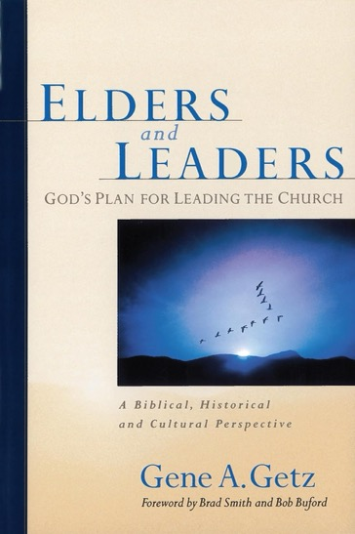
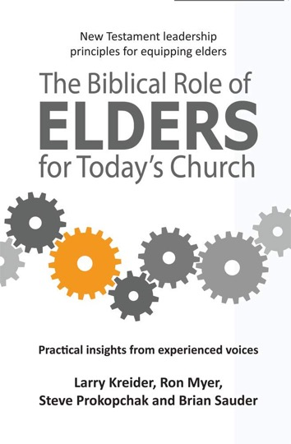



Resources

Slide 54
Resources
“Elders, Deacons and More”
A 5-Part Series with Marshall Mead
October - November, 2023
https://www.orlandochurch.org/sermons/

